Slide 1
Multi-task Learning For Image Tagging
Wayne Thompson, SAS
@Thompson_Wayne (Twitter)

Slide 2



Agenda
Machine Learning with SAS & Domino Data Lab
SAS Deep Learning Toolkit
Multi-Task
Deep Learning
Demo & Closing Statements

Slide 3

Deep Learning
More Compute Power
More Complex Models
Deep Learning
Larger Data Sets
Better Algorithms
Notes:
In most of my presentations I spend time describing what deep learning is . Thanks to our speaker earlier I don’t need to do that. Deep Learning to SAS is about building Big Models on Big Complex Data on Big Compute. Deep Learning is also like a SWISS army knife in that it is good for regression and classification, computer vision, and speech to text. At SAS we have 2 strategies for applying deep learning. 1. At SAS we like to eat our own dogfood. We are embedding Deep Learning and other technologies like NLP to do suggestive BI, image tagging all the way to reinforcement learners in our Customer Intelligence suite to derive policies that improve the customer experience.
We also used a RNN to forecast energy production at our own solar frame located just outside in this direction. DL naturally was able to isolate interactions across the feature set and produce a MAPE that was much better than our traditional forecasting model.
A secondary goal which is just as important is to enable you to embed AI into applications you build, problems you want to solve.

Slide 4
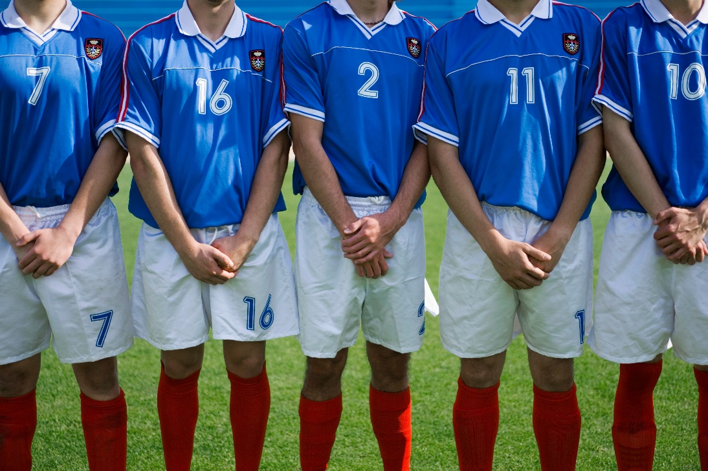
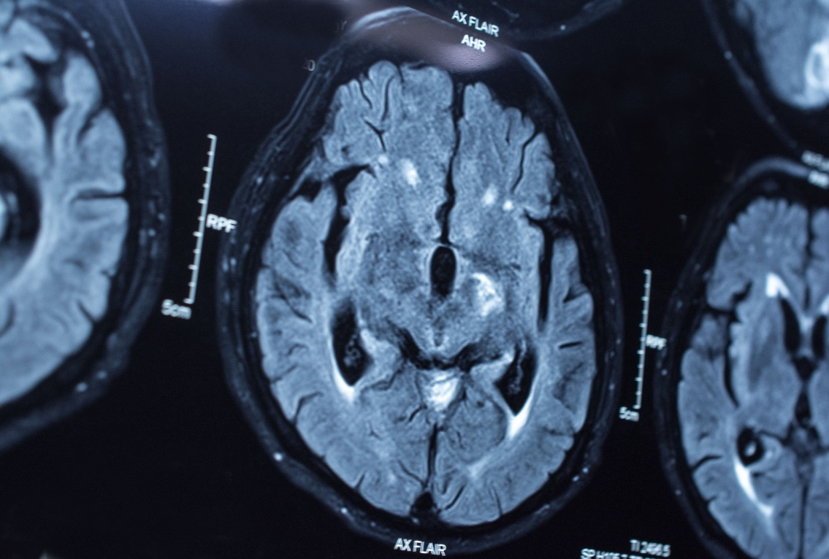
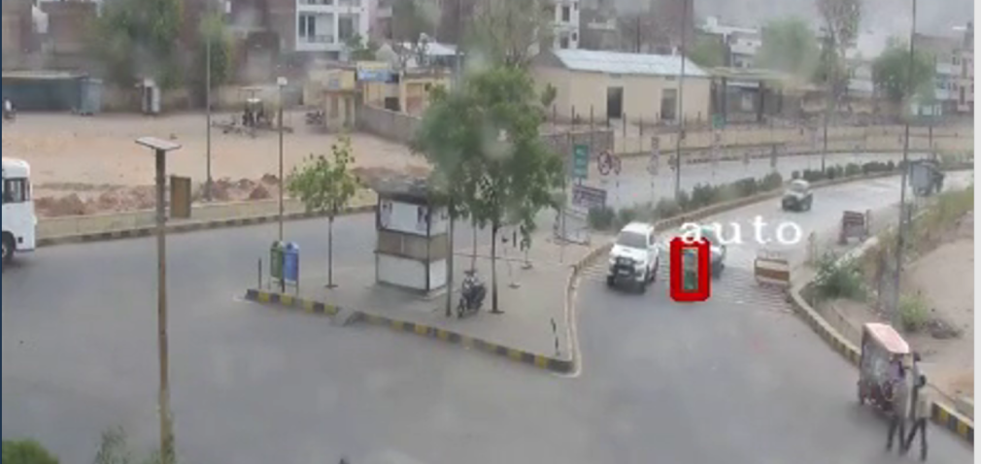
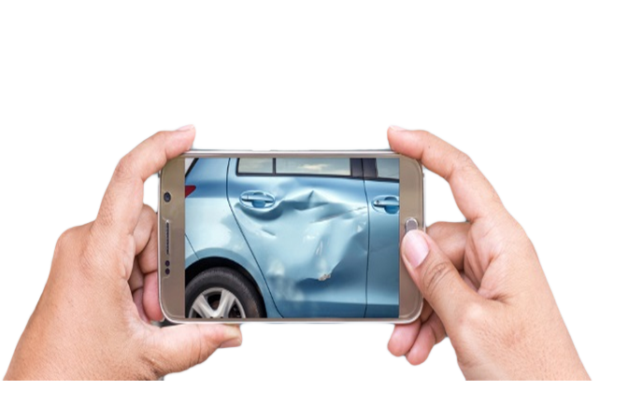
Sample Deep Learning Use Cases @SAS
Person/Object Identification
Three-Dimensional Scans
1
2
3
4
Traffic Surveillance
Insurance Claims
Notes:
Great Eastern Insurance Singapore

Slide 5
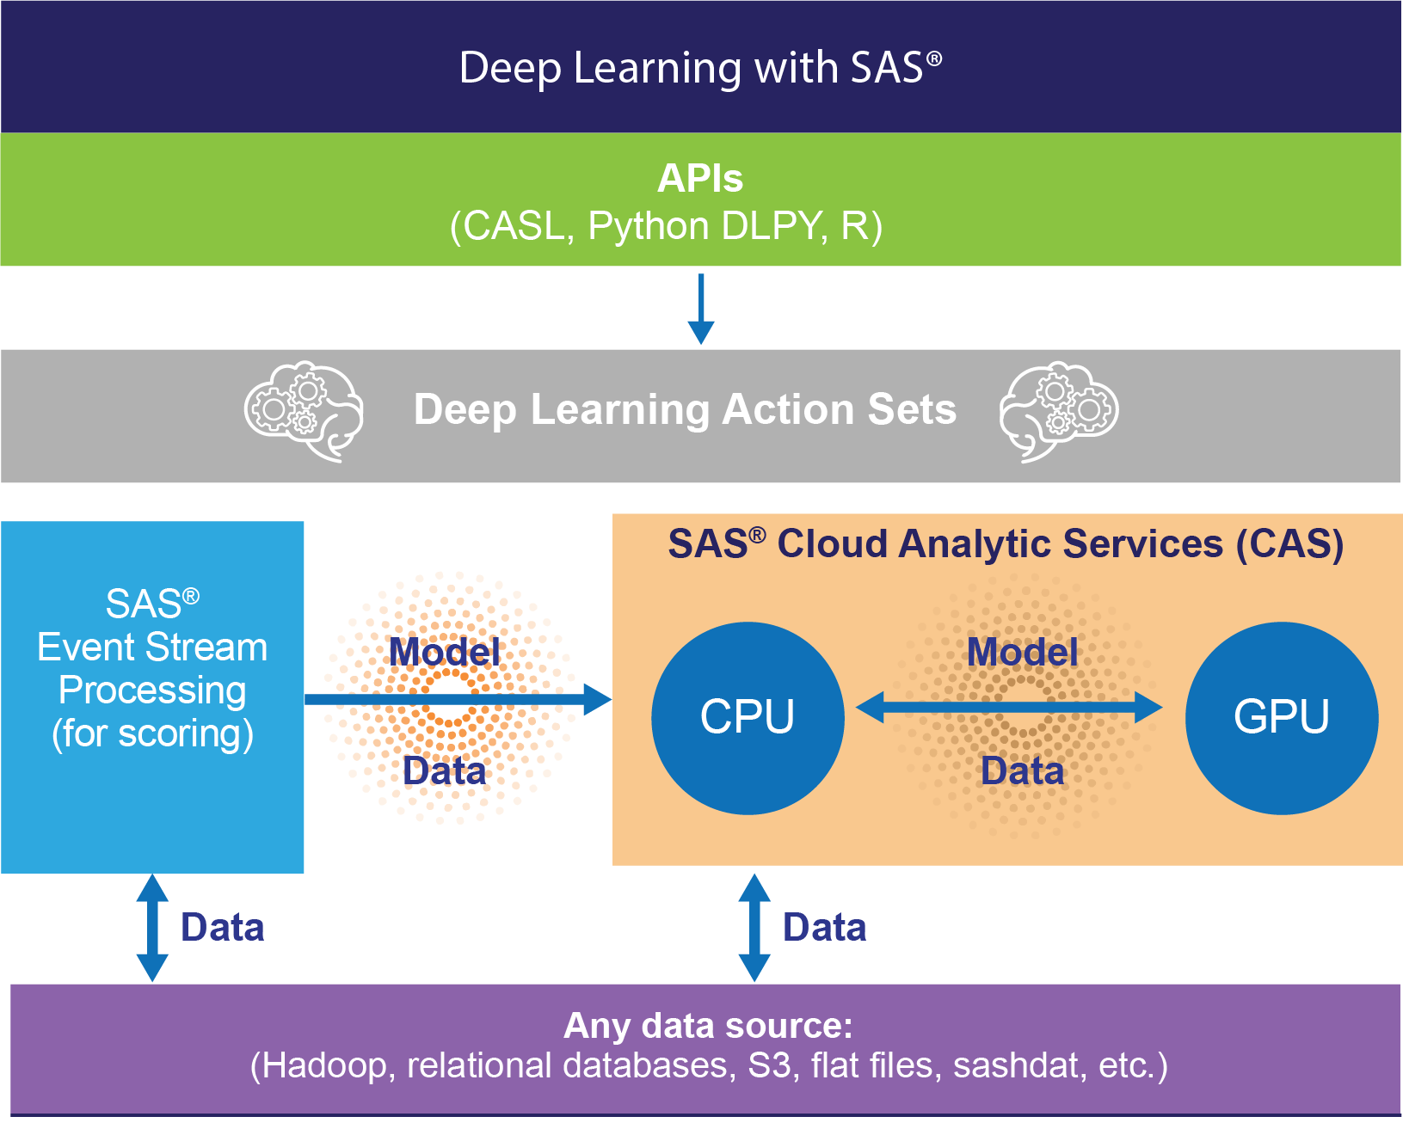
SAS DL Compute Platform
ESPPy
Notes:
Most of us are familiar with data scientists. It's the sexiest job title on the market today. They're data ninjas. They’re able to bend the data in ways that make it easy to work with. Data scientists are in high demand, and there aren't enough of them in the market. Many data scientists are highly trained, but may lack domain expertise. How do you bridge the gap between the analytics and the domain? Most organizations have a lot of analysts, report builders, or even SAS users who may not be specialized in the analytics. Analysts, report builders, and non-stat focused SAS users often have a tremendous amount of experience with the business.
Characteristics of a citizen data scientist:
Great with data
Dabbled in analytics, not classically trained statistician
Approachable analytics is the citizen data scientist’s perfect match

Slide 6
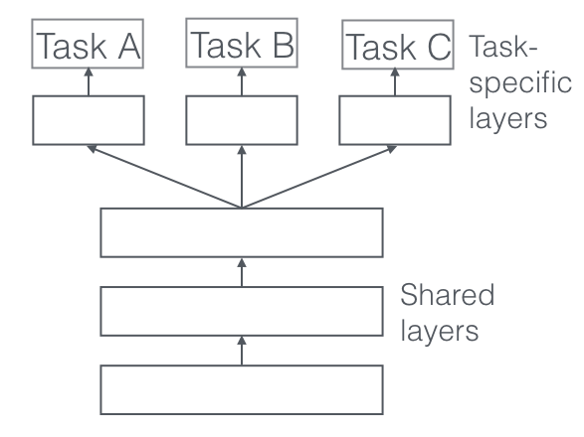
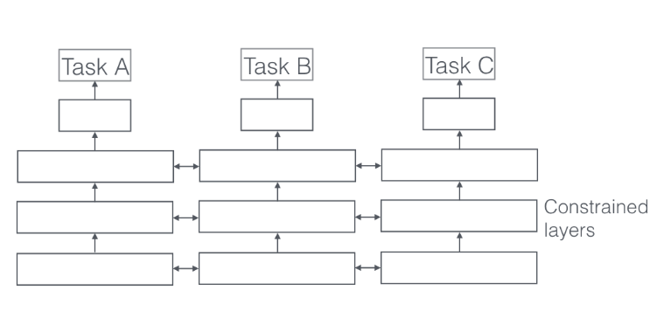
Multitask Learning
Hard Parameter Sharing
Soft Parameter Sharing
Notes:
Also called “Joint Learning”, “Learning to Learn” and “Learning with Auxiliary Tasks” , MTL is a learning paradigm in machine learning and its aim is to leverage useful information contained in multiple related tasks to help improve the generalization performance of all the tasks
MTL is inspired by how we humans learn where we often apply the knowledge learned from previous tasks to help learn a new task. For example, for a person who learns to play tennis can also learn to play racquetball and vice versa. Where tasks can benefit from shared labels.
Unlike Softmax learning where each image has one label an image can have multiple labels. Not assigning a single label to an image but multiple
** Archiecture
Generally, as soon as you find yourself optimizing more than one loss function, you are effectively doing multi-task learning (in contrast to single-task learning).
Tasks can be a mixture of supervised and unsupervised.

Slide 7
Primary MTL Advantages
1
Implicit Data Augmentation
2
Attention Focusing
3
Eaves dropping
Notes:
Implicit Data Augmentation -increases the sample size that we are using for training our model. As different tasks have different noise patterns, a model that learns two tasks simultaneously is able to learn a more general representation.
Attention Focusing - MTL can help the model focus its attention on those features that actually matter as other tasks will provide additional evidence for the relevance or irrelevance of those features.
Eavesdropping - some features GG are easy to learn for some task BB, while being difficult to learn for another task AA. This might either be because AA interacts with the features in a more complex way or because other features are impeding the model's ability to learn GG. Through MTL, we can allow the model to eavesdrop, i.e. learn GG through task BB. The easiest way to do this is through hints ^{[10]}, i.e. directly training the model to predict the most important features.

Slide 8
Candidate Applications
Heath and
Life Sciences
Manufacturing and Energy
Banking
Government
Retail
Fraud Detection
Identification
Smart Cities
Political Campaigns
Image Tagging
Medical Image Analysis
Defect Detection
Notes:
NLP --- given this one for across all.

Slide 9
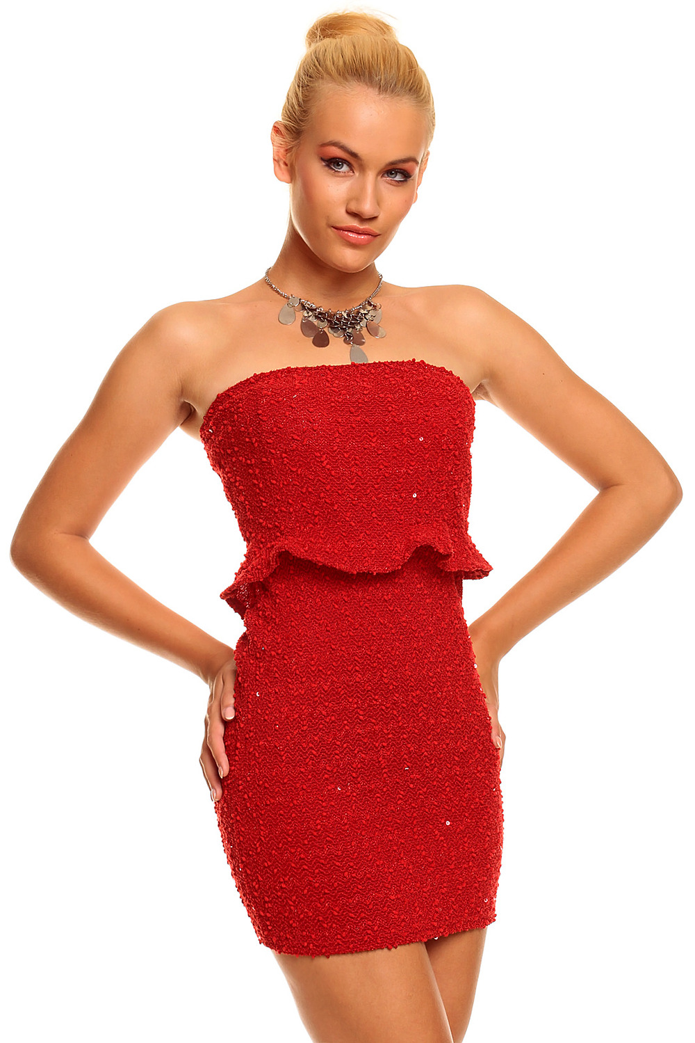

Fashion Items
Tag Attributes & Recommend Items
Currently have separate models to predict
Color
Type of Clothing
Texture
Build one multi-task deep learning model to predict all labels.

Slide 10

Demo Path
Model Training and Edge Deployment with Viya
SAS® VDMML
SAS® ESP
Video Footage/
Streaming Images
Load Images
Ingest ASTORE
Load Images
Raw Video /
Image Data
Process Images
Preprocess Images
Train Deep Learning Models
Score Images In-stream
Feedback into Control Systems
for Optimization and Triggering Alerts
Generate ASTORE
Post-process Computation

Slide 11



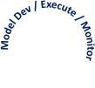
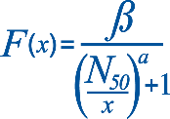




Demo Path
Train
ETL
Enrich
Store
Score
Automated Response
Notes:
Most of us are familiar with data scientists. It's the sexiest job title on the market today. They're data ninjas. They’re able to bend the data in ways that make it easy to work with. Data scientists are in high demand, and there aren't enough of them in the market. Many data scientists are highly trained, but may lack domain expertise. How do you bridge the gap between the analytics and the domain? Most organizations have a lot of analysts, report builders, or even SAS users who may not be specialized in the analytics. Analysts, report builders, and non-stat focused SAS users often have a tremendous amount of experience with the business.
Characteristics of a citizen data scientist:
Great with data
Dabbled in analytics, not classically trained statistician
Approachable analytics is the citizen data scientist’s perfect match

Slide 12

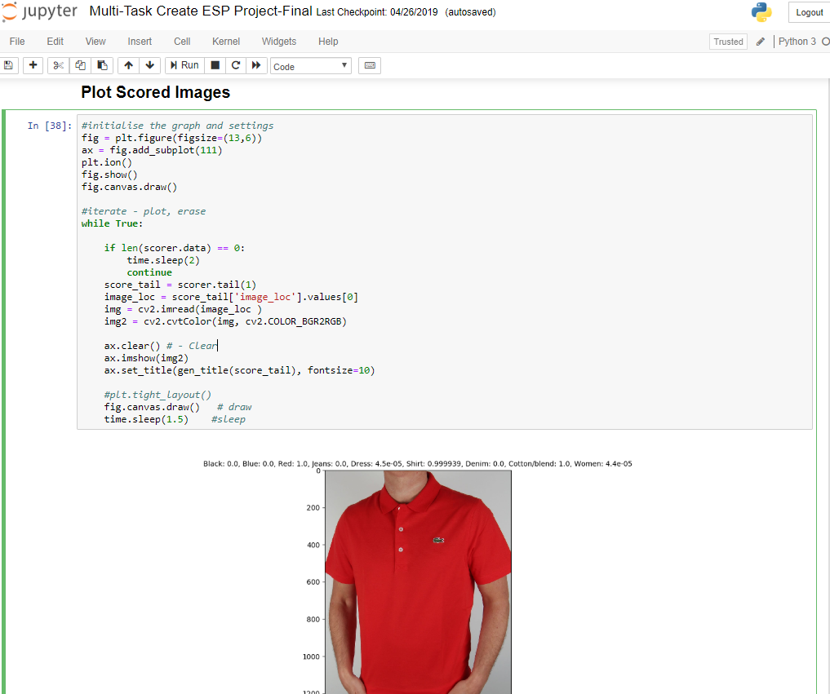
SAS DLPy & ESPPy Demo

Slide 13


Thank you.

Slide 14
Notes
Challenges - viewpoint variation, scale variation, intra-class variation, image deformation, image occlusion, illumination conditions, background clutter

